Slide 1
LECTURE 3
NUMBER SYSTEMS

Slide 2
NUMBER SYSTEMS
Objectives:
Convert a number from one base to another.
Perform addition in 1 and 2's complement.
Code numbers in the various forms of information representations.

Slide 3
NUMBER BASES
Counting number is a unique digit for a number in different base systems
What is the difference between Number and Numeral?
Number shows "how many“ or "how much" of some quantity.
Numerals are symbols used to represent the quantity ("how many”) in writing.
e.g. The number of students in a class = 20 in base 10,
E in base 16,
24 in base 8.

Slide 4
Conversion from an Arbitrary Base to Base 10
General representation of a number in base 10:
E.g. 246 base 8 in decimal numeral

Slide 5
Conversion of Fraction from Arbitrary Base to Decimal
Example:
Example:

Slide 6
Base 10 to an Arbitrary Base
Find the binary (base 2) representation of 10.
10 in base 10 = 1010 base 2
2 | 10 | R
 | 5 | 0
2 | 5
 | 2 | 1
2 | 2
 | 1 | 0
2 | 1
 | 0 | 1

Slide 7
Decimal Fractions to Base n
Multiply by n . (Product)
Integral part(i.e. the whole number part) is the base n digit
Fractional part is multiplied by n.
Repeat above step until either;
a zero value is obtained for the fractional part.
the number of significant digits is obtained.
the fraction keeps recurring.

Slide 8
Eg. 0.62510 to binary
0.52510 to binary to 6 sig. digits
1000012 to 6 fractional places

Slide 9
QUESTION:
Find the hexadecimal(base16) representation of 366.6410
Step 1:
Successively divide the integral part (366) by 16 and store the remainders.
Step 2:
Successively multiply the fractional party (0.64) by 16 and store the integral part of the products.

Slide 10
Find the base 6 representation of 232.234
Step 1
Convert 232.234 to base 10 = 46.6875
Step 2:
Successively divide the integral part (46) by 6 and store the remainders.
Step 3
Successively multiply the fractional party (0.6875) by 6 and store the integral part of the products.

Slide 11
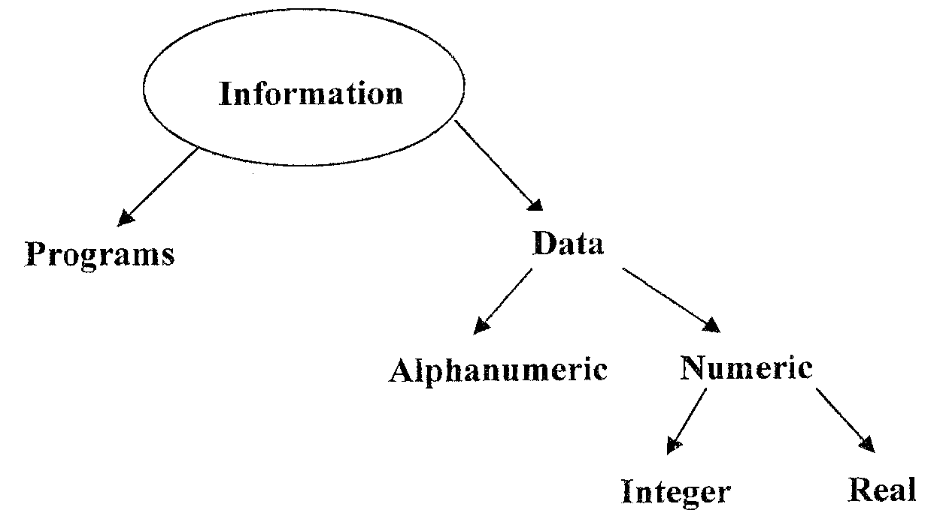
INFORMATION REPRESENTATION IN COMPUTERS
Numbers, characters and instructions are represented in bits.
Bit : Binary unit of information (0,1)

Slide 12
UNSIGNED INTEGERS
Represented by binary numerals.
The larger the magnitude of the number, the greater the number of bits required in the binary representation.
The smallest number that can be represented is 0.
The largest is 2^{n} – 1 , where n is the number of bits.

Slide 13
SIGNED INTEGERS
Schemes for representing signed integer:
Sign – magnitude
One's complement
Two's complement.
All 3 methods have one common feature:
The leftmost bit is reserved to represent the sign of the integer.
(0= positive and 1 = negative)

Slide 14
SIGN ‑ MAGNITUDE
Sign: Leftmost bit
Magnitude (Absolute value) : remaining bit
E.g. On an 8‑bit machine, the integers 30 and ‑30 would be represented as follows:
30 : 00011110
– 30 : 10011110
Integer range : –2^{n-1} –1 to 2^{n-1} –1
Drawback: It requires several tests and decisions

Slide 15
ONE'S COMPLEMENT
Sign (Leftmost bit) : initially set to zero.
Absolute value : remaining bits
For a negative number: complement (invert) all bits. Note that this will make the sign bit "1" as it should be.
E.g. 1's complement representation of 30 and‑30 are:
30 : 00011110
‑30 : 11100001
Drawback:
‑0 and +0 are represented differently
Most computers now use a variation of 1's complement (called 2's complement) that eliminates this problem.

Slide 16
ADDITION IN ONE'S COMPLEMENT
Carry over of leftmost digit ( of results) is added back to the bit string.
Example: Add ‑1 and +5 on a 4‑bit machine :
NB: The carry over of the leftmost digit of the results is added back to the bit string.

Slide 17
TWO'S COMPLEMENT
Positive numbers are treated like one's complement.
Negative numbers are obtained by adding 1 to one's complement.
Start with the absolute value in binary
Then complement all the bits
Add 1 to the resulting number
E.g. Two's complement representation of ‑30 in 8 bits is:

Slide 18
ADDITION IN 2'S COMPLEMENT
Add bit strings as an unsigned number
Ignore or drop carry over of leftmost bit.
Example:
Add 92 and ‑45 in 2's complement using 8 bits

Slide 19
In general, using n bits, the total number of bits representation is
For positive and negative numbers,
zero in the leftmost bit will represent the positive integers
One will represent the negative integers.
Therefore using n bits, the range of integers that can be stored in two's complement is:

Slide 20
TO ILLUSTRATE:
Using 4‑bits, 16 binary patterns are obtained:
i.e. from 0000 to 1111.
8 begin with 0 (positive) and 8 begin with 1 (negative).
The largest positive integer that can be represented with 4 bits is:

Slide 21
QUESTION:
Which negative integers are represented by the bit patterns beginning with 1?
To find out, we follow these steps:
If leftmost digit is 1, then the integer being represented is negative.
If negative, find the absolute value:
Subtract 1 from representation
Invert bits in new pattern
New pattern represent absolute value of negative number

Slide 22
Example: Consider 1011
Solution:
Inverted, 1010 becomes 0101 which is 5(in base10)
Therefore 1011 = -5
2's compliment representation therefore gives:
‑1 represented by 1111 ‑5 represented by 1011
‑2 represented by 1110 ‑6 represented by 1010
‑3 represented by 1101 ‑7 represented by 1001
‑4 represented by 1100 ‑8 represented by 1000

Slide 23
Binary Coded Decimal (BCD) Representation
Number to be stored is treated as a set of digits and the binary equivalent of each digit is stored (in four bits each).

Slide 24
EXAMPLE:
To store 378:
Obtain binary equivalent of 3, 7, and 8 respectively.
i.e. 3: 0011
7: 0111
8: 1000
We need a minimum of 4 bits for each digit
To represent the sign, any of the remaining bit patterns can be used.

Slide 25
Representation Of Real (Floating Point) Numbers
Similar to scientific notation.
Floating-point representation consists of a/an:
Mantissa (m)
exponent (e)
sign bit (s)
The value of a floating point number, N is given by:

Slide 26
In a normalized mantissa,
An n bit mantissa has the general form:
b0, is always 1 and is omitted from the floating point representation and is called the hidden bit.
Note: Using the hidden bit convention, there is no floating point representation for zero.

Slide 27
Decimal to Floating Point Conversion
To convert a decimal number to binary floating point representation:
Convert the absolute value of the decimal number to a binary integer
plus a binary fraction.
Normalize the number in binary scientific notation to obtain m and e .
Set s = 0 for a positive number and s = 1 for a negative number.

Slide 28
To convert 22.625 to binary floating point:
Convert decimal 22 to binary 101102.
Convert decimal 0.625 to binary 0.1012
Combine integer and fraction to obtain binary 10110.1012
Normalize binary 10110.101 to obtain
Thus, and
The number is positive, so

Slide 29

IEEE Floating Point Standard
Most widely accepted standard representation for floating point numbers.
It provides definitions for single precision and double precision representations.
The single precision IEEE FPS format is composed of 32 bits, divided into a 23 bit mantissa, M, an 8 bit exponent, E, and a sign bit, S

Slide 30
The normalized mantissa, m, occupies bits 0‑22 with the hidden bit omitted. Thus M = m-1
The exponent, e, is represented as a bias 127 integer in bits 23‑30. Thus, E = e+127.
The sign bit, S, indicates the sign of the mantissa, with S=0 for positive values and S=1 for negative values.
Zero is represented by E = M = 0. Since S may be 0 or 1
Floating point division by zero produces a number with E=255 and nonzero M called NaN (Not a Number).

Slide 31

To convert decimal 17.15 to IEEE FPS:
Convert decimal 17 to binary 10001.
Convert decimal 0.15 to the repeating binary fraction 0.001001.
Combine integer and fraction to obtain binary 10001. 001001
1.Normalize the binary number to obtain
2.E = e+127 = 131 = 1000 0011.
3.The number is positive, so S=0.
4.Align the values for M, E, and S in the correct fields.

Slide 32
The range of values for the mantissa, m, is between 1 and
Because E=0 and E=255 are reserved, the range of values for the exponent, e, is between ‑126 and +127.
The largest positive number that can be represented is approximately 2.2¹²⁷ = 2¹²⁸.

Slide 33
Representation Of Alphanumeric Data
Alphanumeric data consists of letters (A‑Z), digits (0‑9)
Various special symbols, such as +, ‑, > *=,?, etc.
The binary patterns used to represent characters are called codes.
74 unique bit strings are needed to serve as codes for the entire character set.
uppercase letters : 26
lowercase letters : 26
Digits (0‑9) : 10
Special Characters: 12

Slide 34
The two coding schemes most frequently used for the representation of character information by computers are:
ASCII (American Standard Code for Information Interchange) ‑ 7‑bit code
EBCDIC (Extended Binary Coded Decimal Information Code) ‑ 8‑bit code
e. g. 7‑bit ASCII 8‑bit EBCDIC
0 0110000 11110000
1 0110001 11110001
: : :
A 1000001 11000001
+ 0101011 01001110

Slide 35
Each digit is stored in one nibble of a byte, with the other nibble being set to all zeros or all ones (as in the EBCDIC code), or to 0011 (as in the ASCII code)
ASCII (American Standard Code for Information Interchange) ‑ 7‑bit code
EBCDIC (Extended Binary Coded Decimal Information Code) ‑ 8‑bit code
The seven (7) bits gives 128 different bit patterns
only 74 are used for the character set.
The unused codes are used to represent the control characters.

Slide 36
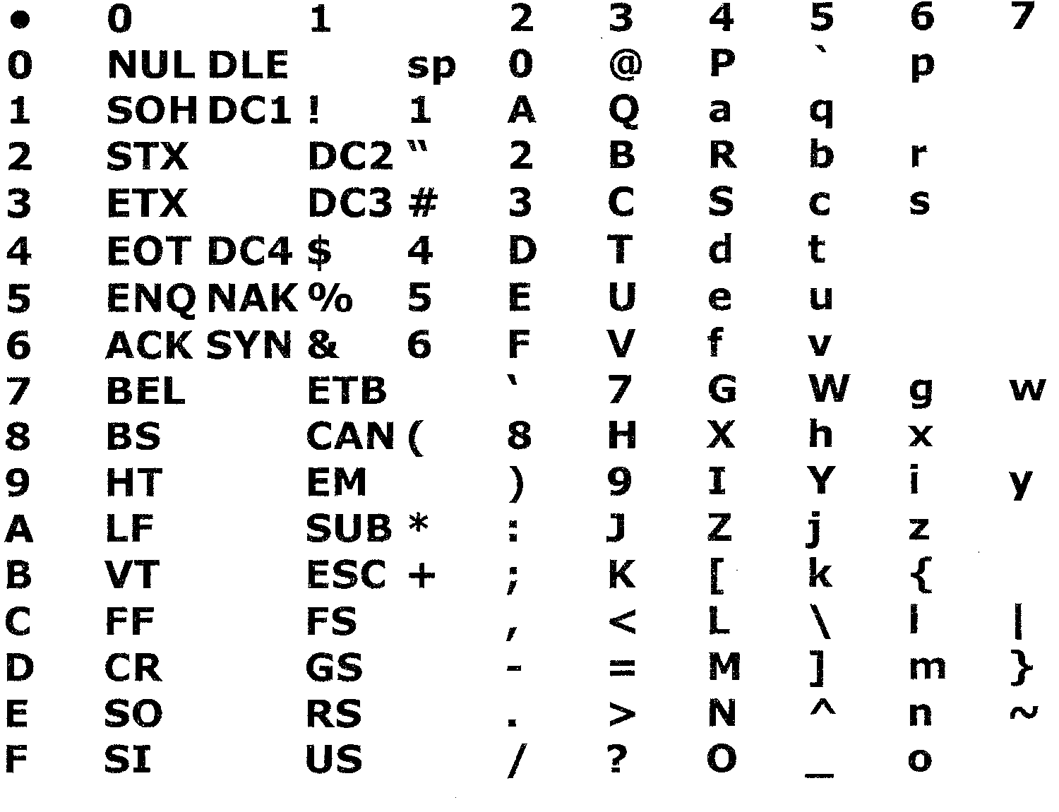
ASCII Table

